Slide 1
D.T2.4.2 Joint Social Entrepreneurial Skills and Competences training
Business Model Traning_Homework
IN SITU, STEP RI PP8, Boris Golob

Slide 2
Homework
Document business model of an existing local social entrepreneurship initiative:
Choose the most appropriate canvas type (BMC, BMCB, SBMC, 3PBMC, MMC)
Identify business model elements
Understand „the story” – relationships between BM elements with focus on sustainability
Prepare short presentation (up to 5 min)
Send ppt by Jun 13th to anita.pribanic@uniri.hr, presentations June 15th (TTT Session 6)

Slide 3
VP 1
Activity 1
Customer relationship 1
Customer 1
Partner 1
VP 2
Customer 2
Resource1
VP 3
Channel 1
Customer 3
Cost1
Revenue 1
Revenue 3
Revenue 2

Slide 4
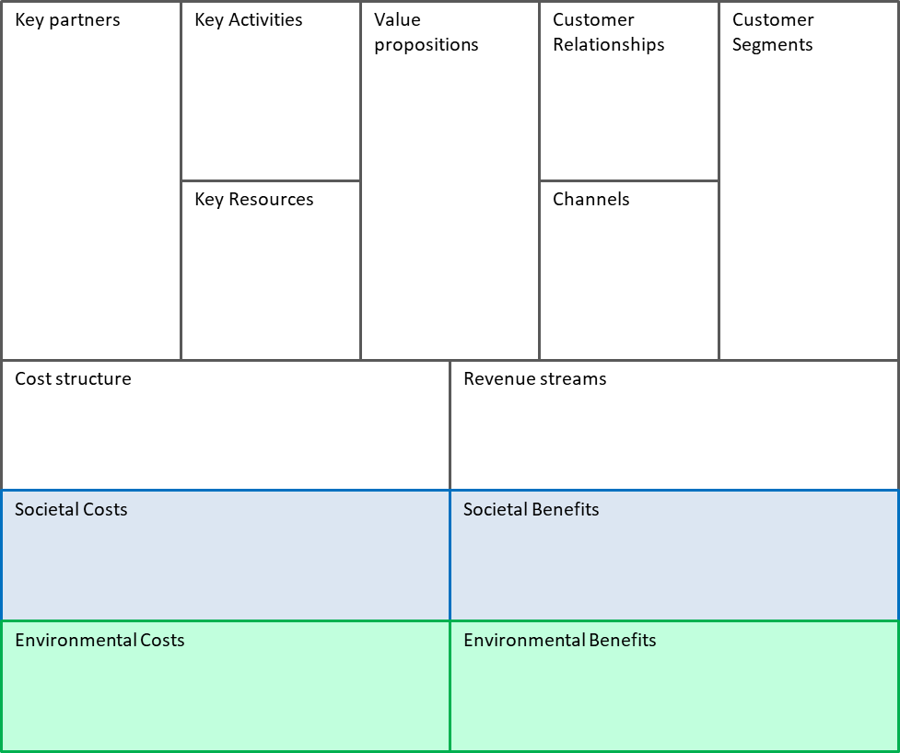
VP 1
Activity 1
Customer relationship 1
Customer 1
Partner 1
VP 2
Customer 2
Resource1
VP 3
Channel 1
Customer 3
Cost1
Revenue 1
Revenue 3
Revenue 2
Societal Cost1
Societal Benefit1
Environmental Cost1
Environmental Benefit1

Slide 5
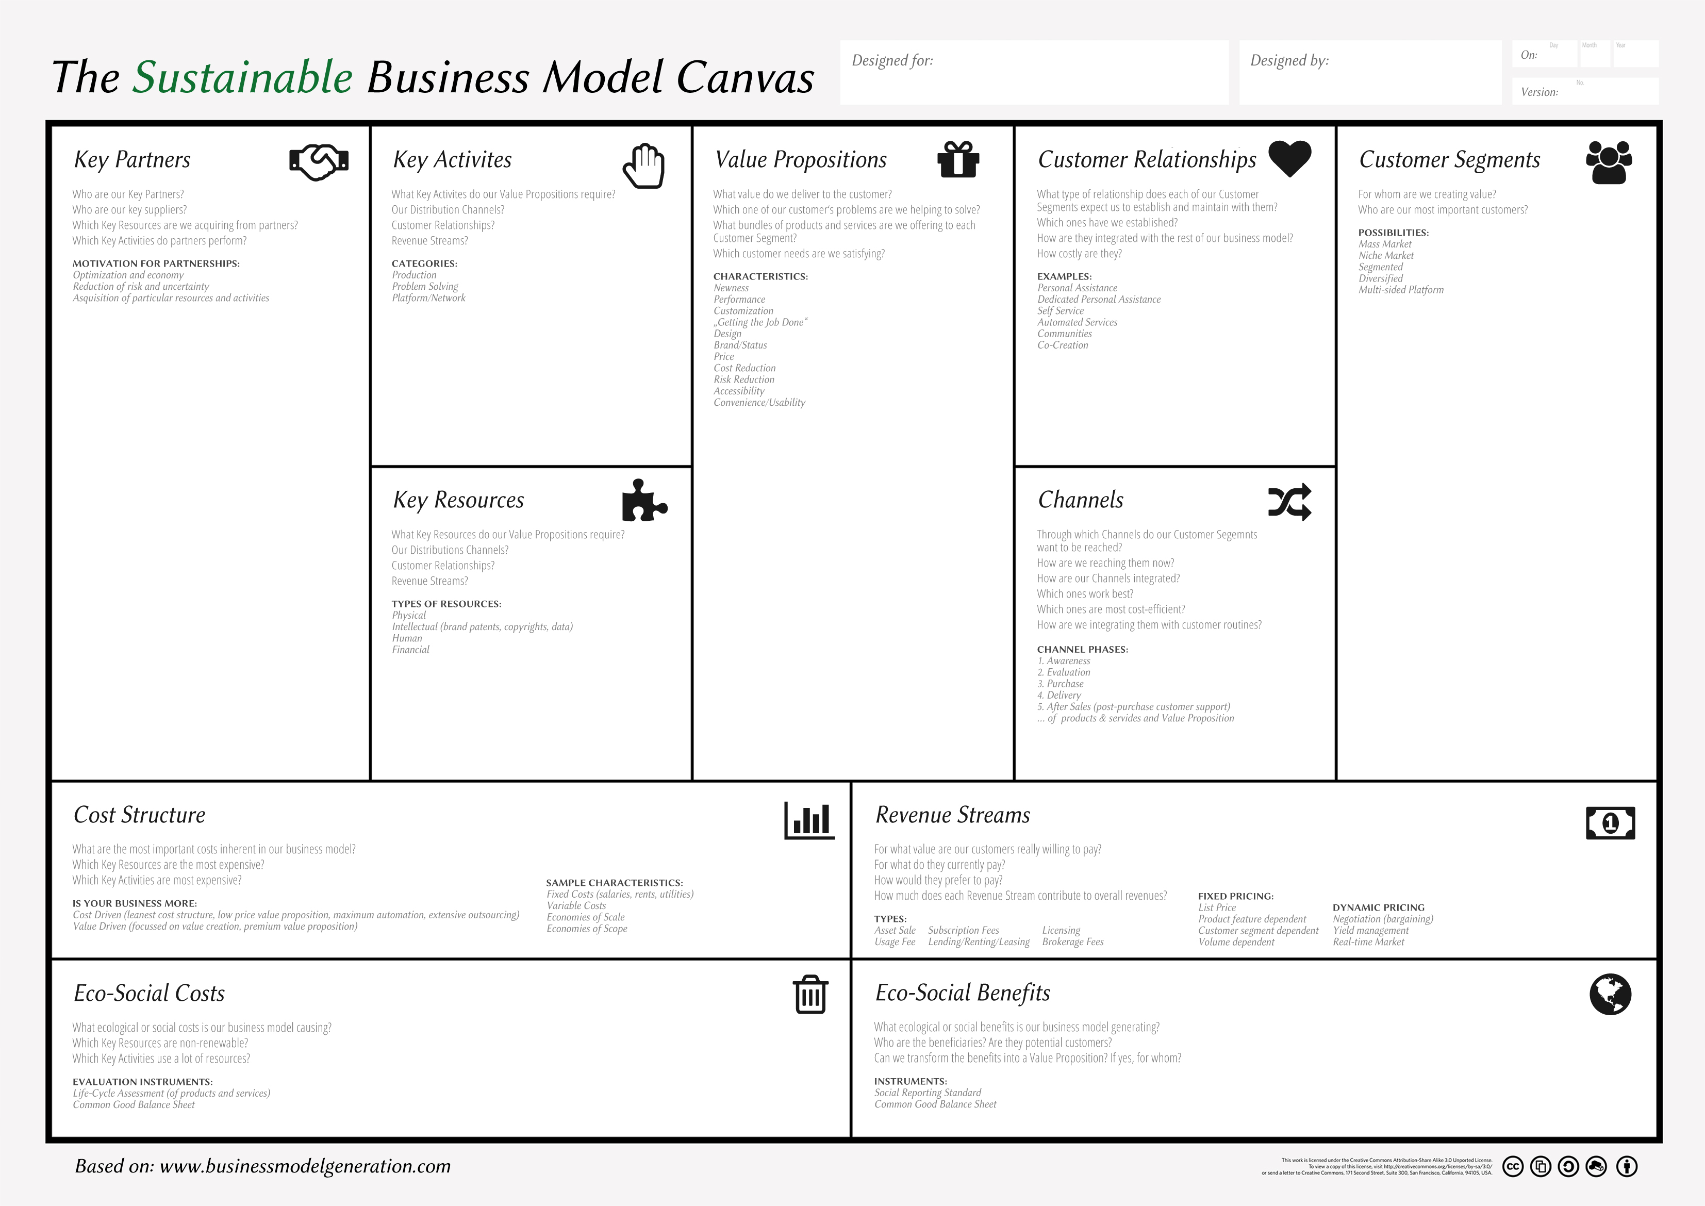
VP 1
Activity 1
Customer relationship 1
Customer 1
Partner 1
VP 2
Customer 2
Resource1
VP 3
Channel 1
Customer 3
Cost1
Revenue 1
Revenue 3
Revenue 2
Societal Cost1
Environmental Cost1
Societal Benefit1
Environmental Benefit1

Slide 6
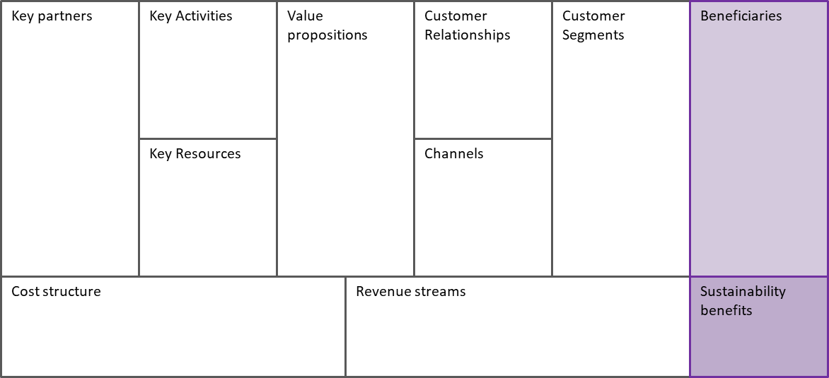
VP 1
Activity 1
Customer relationship 1
Beneficiary 1
Customer 1
Partner 1
VP 2
Customer 2
Resource1
VP 3
Channel 1
Customer 3
Cost1
Revenue 1
Revenue 3
Revenue 2
Benefit 1

Slide 7
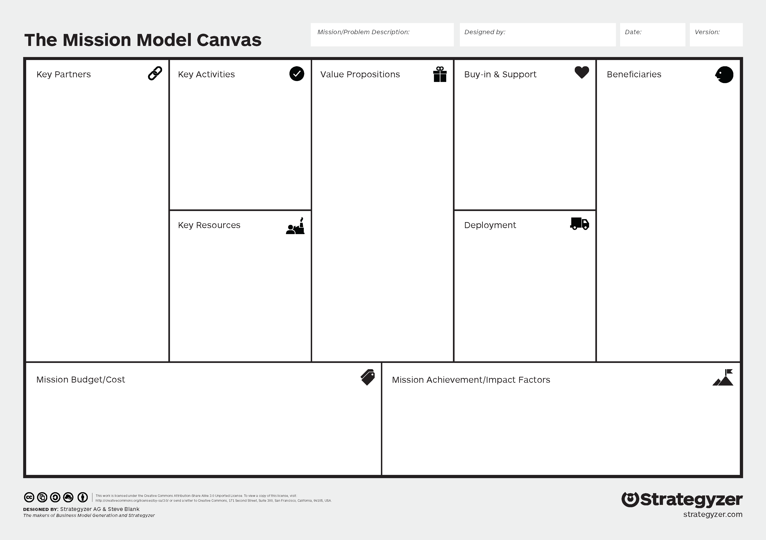
VP 1
Activity 1
Buy-in & Suport 1
Beneficiary 1
Partner 1
VP 2
Beneficiary 2
Resource1
VP 3
Deployment 1
Beneficiary 3
Cost1
Achievement Impact
1
Achievement Impact
3
Achievement Impact
2

Slide 8
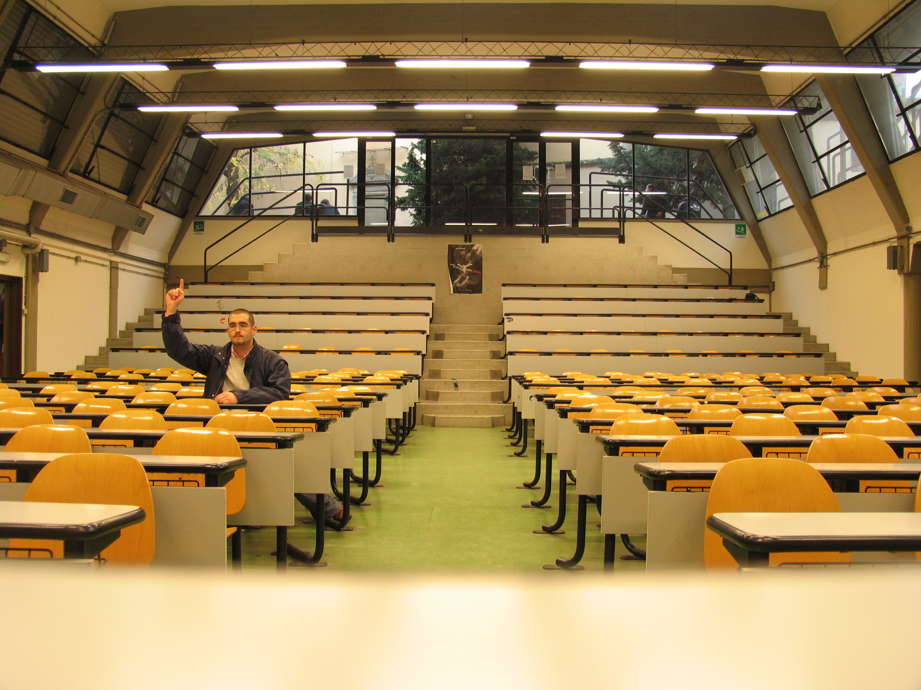
Questions?

Slide 9
Thank you for your attention!
bgolob@uniri.hr
STEP RI Ltd.
Science and Technology Park of the University of Rijeka
Radmile Matejčić 10, 51000 Rijeka, Croatia

